Slide 1

Noida Institute of Engineering and Technology, Greater Noida
Financial Analysis
Unit: III
Project Management
AOE0761
Harshit Thakur
Assistant Professor
CSE
B. Tech Semester VII

Slide 2
Index
S. No. | Content
1. | Name of Subject with code, Course and Subject Teacher
2. | Brief Introduction of Faculty member with Photograph
3. | Evaluation Scheme
4. | Syllabus
5. | Branch wise Application
6. | Course Objective(s)
7. | Course Outcome(s)
8. | Program Outcomes (PSOs)
9. | Cos and POs Mapping

Slide 3
Index
S. No. | Content
10. | Program Specific Outcomes (PSOs)
11. | Cos and PSOs Mapping
12. | Program Educational Objectives (PEOs)
13. | Result Analysis
14. | End Semester Question paper Templates
15. | Prequisite/Recap
16. | Brief Indtroduction about the Subject with Videos
17. | Unit Contents
18. | Unit Objectives
19. | Topic Objectives/Topic Outcome

Slide 4
Index
S. No. | Content
20. | Lecture related to topic
21. | Daily Quiz
22. | Weekly Assignment
23. | Topic Links
24. | MCQs
25. | Glossary Questions
26. | Old question papers
27. | Expected Questions
28. | Recap of unit

Slide 5
Introduction of Faculty member
Faculty Name: Harshit Thakur
Designation: Assistant Professor
Department: CSE
Email ID: harshit.thakur@niet.co.in
Qualification: M.Tech, B.Tech
Specialisation: CSE
Research Area: Cloud Computing
Total Experience: 1 Year

Slide 6
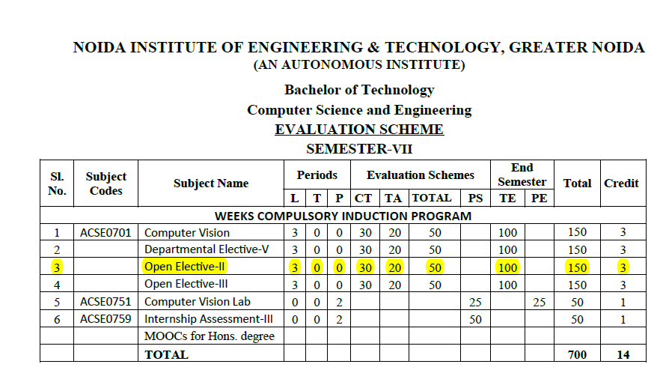
Evaluation Scheme

Slide 7
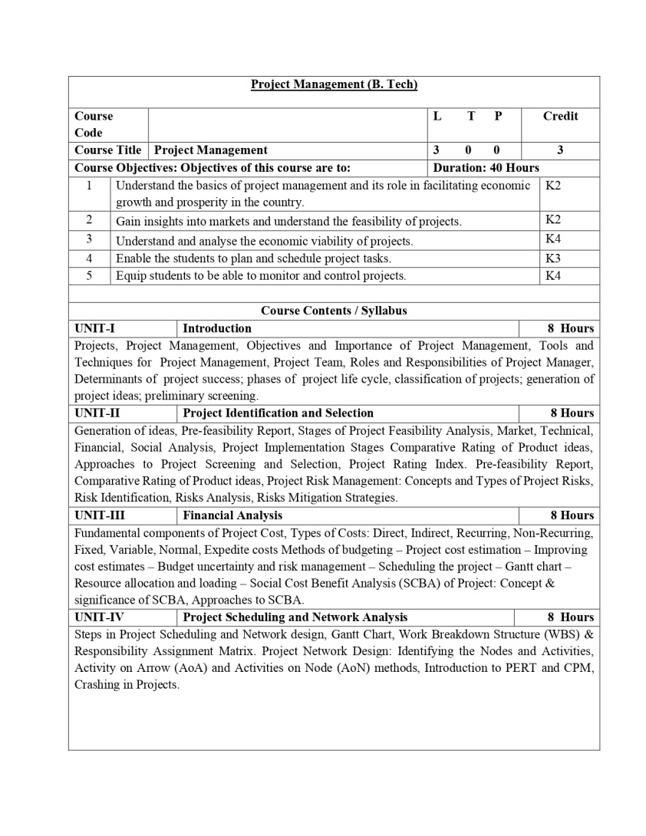
Syllabus

Slide 8
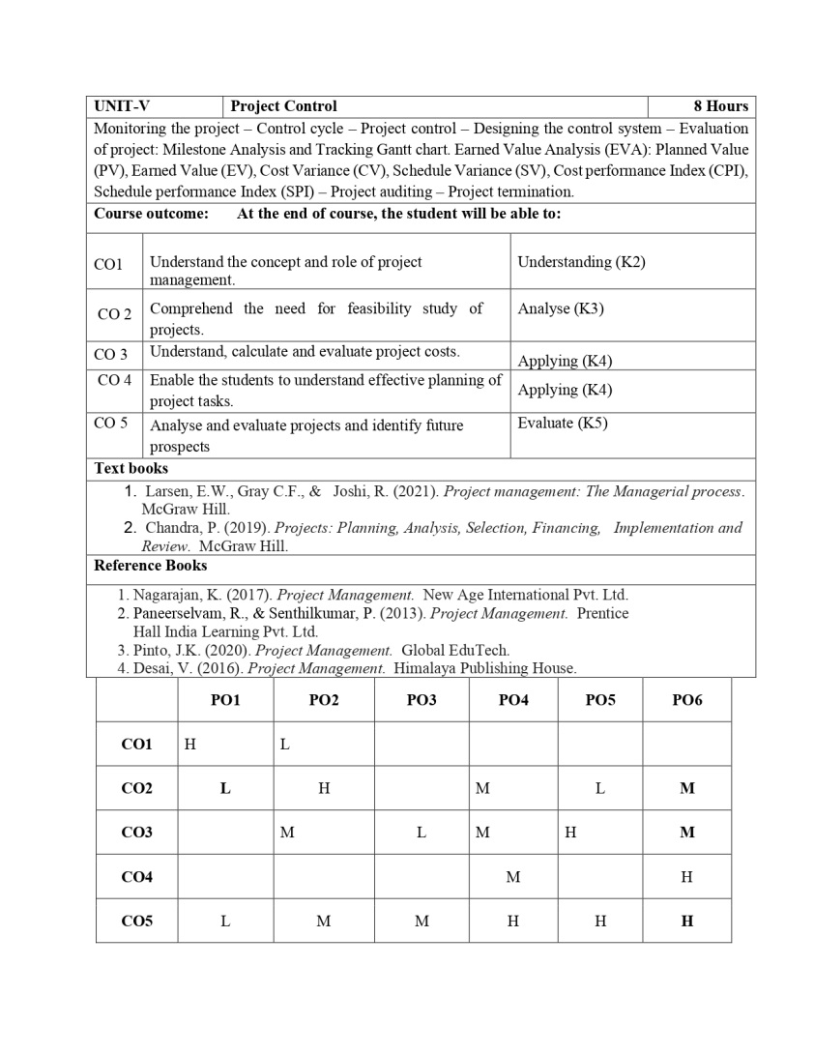
Syllabus

Slide 9
Branch Wise Application
Handling projects.
Evaluating & Monitoring Project Process
Taking necessary and corrective action.

Slide 10
Course Objectives
To empower the students to get insights of basic concepts on project management.
To create awareness on the roles and responsibilities of project manager.
To build the confident among the students to take up any kind of projects.
To sharpen the planning, scheduling and controlling skills of the students with respect to individual projects.
To understand the perspectives in which optimum decisions are to be taken in case of risks with planned activities in project.

Slide 11
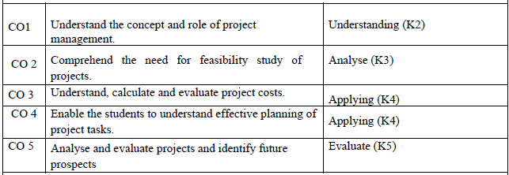
Course Outcome

Slide 12
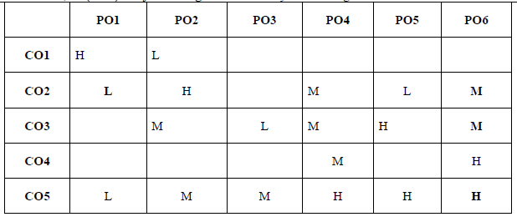
CO-PO and PSO Mapping
*1=High, *2=Medium, *3=Low

Slide 13
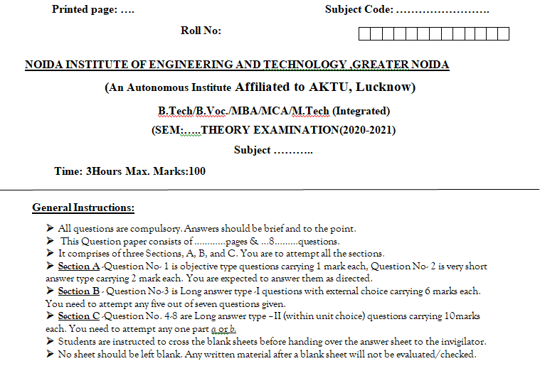
End Semester Question Paper Template

Slide 14
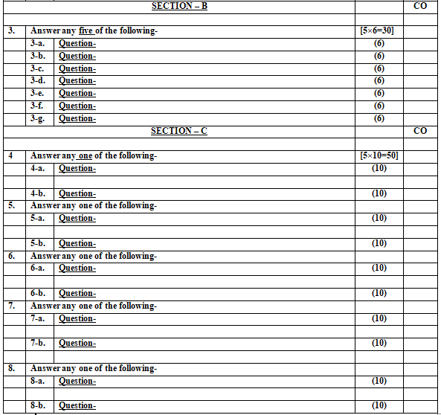
End Semester Question Paper Template

Slide 15
Objective of Unit
Objective of this unit are:
To understand various aspects of Project Costing.
To learn about various Project Financing sources and preparing project budgets.
To understand and conduct he Social Cost Benefit Analysis (SCBA) of a Project.

Slide 16
Content of Unit
Unit-3:
Fundamental components of Project Cost, Types of Costs: Direct, Indirect, Recurring, Non-Recurring, Fixed, Variable, Normal, Expedite costs Methods of budgeting – Project cost estimation – Improving cost estimates – Budget uncertainty and risk management – Scheduling the project – Gantt chart – Resource allocation and loading –
Social Cost Benefit Analysis (SCBA) of Project: Concept & significance of SCBA, Approaches to SCBA. Case Study

Slide 17
Prerequisites and Topic wise Recap
Prerequisites for this session are:
General understanding of project management.
Moderate analytical skills.
Recap:
Project Identification & Selection
Market & Demand Ananlysis Techniques
Project Risk Management

Slide 18
Topic & CO Mapping
S No | Topic | CO | Level
1 | Project Costing: | CO 3 | 1
2 | Project Financing and Budgeting: | CO 3 | 2
3 | Social Cost Benefit Analysis (SCBA) of Project: | CO 3 | 2

Slide 19
Session/ Topic Objectives
To understand various types of project costs and their application .
To learn the about various sources of project financing.
To understand various important aspects of budgeting and preparing project budgets.
To learn about the social cost benefit analysis of projects

Slide 20
Project Cost
The project cost is a cost required to procure all the needed products, services and resources to deliver the project successfully.
Example: In an example of a construction project, the cost estimation starts from land acquisition cost, construction cost, materials cost, administration cost, labor cost and other direct and indirect costs

Slide 21
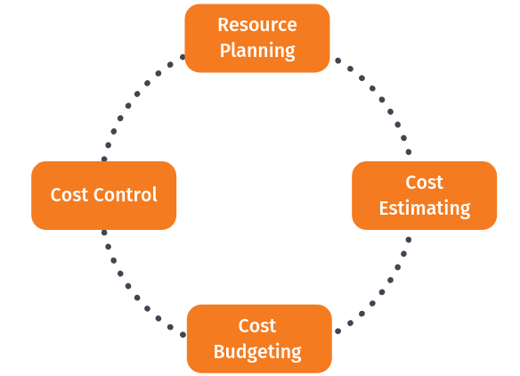
Fundamental Components of Project Costing

Slide 22
Step 1: Resource planning
Resource planning is the process of ascertaining future resource requirements for an organization or a scope of work. This involves the evaluation and planning of the use of the physical, human, financial, and informational resources required to complete work activities and their tasks.
Most activities involve using people to perform work. Some activities involve materials and consumables.

Slide 23
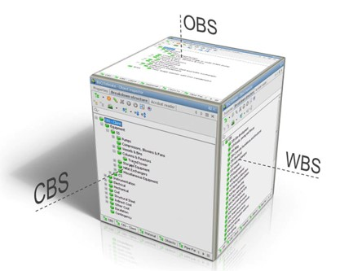
Step 1: Resource planning

Slide 24
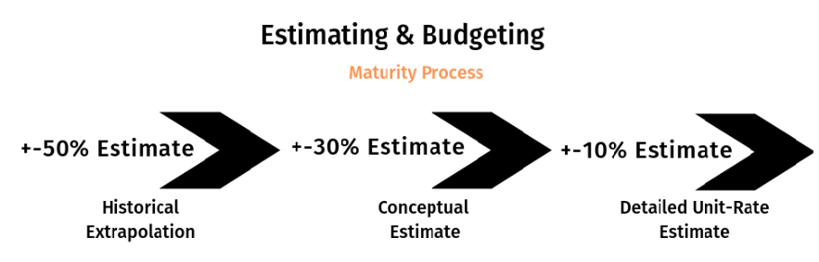
Step 2: Cost estimation

Slide 25
Step 3: Cost budgeting
Budgeting is a sub-process within estimating used for allocating the estimated cost of resources into cost accounts against which cost performance will be measured and assessed. This forms the baseline for cost control.
Cost accounts used from the chart of accounts must also support the cost accounting process. Budgets are often time-phased in accordance with the schedule or to address budget and cash flow constraints.

Slide 26
Step 4: Cost control
Cost control is concerned with measuring variances from the cost baseline and taking effective corrective action to achieve minimum costs. Procedures are applied to monitor expenditures and performance against the progress of a project.
All changes to the cost baseline need to be recorded and the expected final total costs are continuously forecasted.

Slide 27
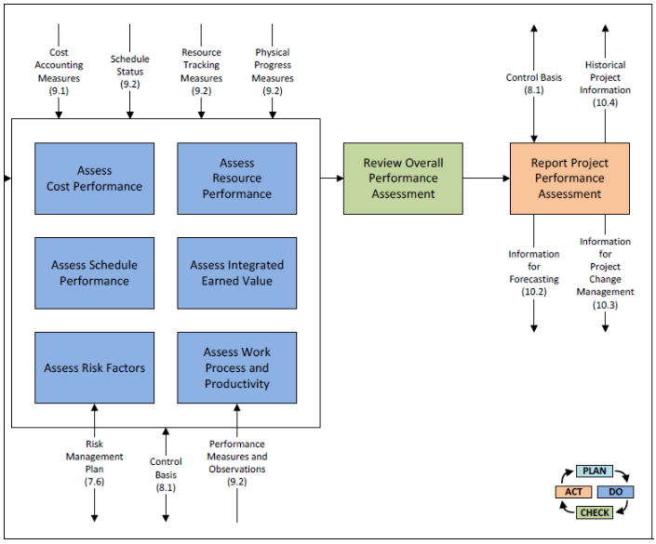
Step 4: Cost control

Slide 28
Cost Estimation
The term ‘cost’ refers to the amount of expenditure incurred on, or attributable to a given things.
Cost of materials
Cost of labour
Cost of overheads
Other expenses

Slide 29
Cost classification
The term ‘cost’ refers to the amount of expenditure incurred on, or attributable to a given things.
Cost of materials
Cost of labour
Cost of overheads
Other expenses

Slide 30
Elements of Cost
Materials= Direct Materials+ Indirect Materials
Labour = Direct Labour + Indirect Labour
Expenses= Direct Expenses + Indirect Expenses
Total Cost= Prime Cost + Overheads

Slide 31
Total Cost= Prime Cost+ Overheads
Prime Cost:
Direct Materials (Prime material, process material, production material, requisitioned material)
Direct Labour or Wages (wages of labour, foreman etc)
Direct Expenses (chargeable expenses, process expenses, productive expenses and prime cost expenses)

Slide 32
Total Cost= Prime Cost+ Overheads
Overheads:
Indirect Materials (oil, grease, waste for machine, brooms, rags and cleaning materials)
Indirect Wages (wage of indirect labours like cleaners, store keeper time keepers, over time etc)
Indirect Expenses (rent, rates and taxes, insurance, canteen expenses, dispensary, hospital, power & lighting etc.

Slide 33
Other Overheads
Factory or manufacturing or works or production overheads- (rent and rates of factory building, salary of production manager, supervisors, foreman, storekeeper etc.)
Administrative or office or general overheads- (rent and taxes of office building, staff salaries, postage and stationery, directors’ fee, bank charges etc.)
c. Selling and distribution overheads- (advertising expenses, salaries and commission to statement, market research expenses etc.)

Slide 34
Costs
Prime cost= Direct material+ Direct labour+ Direct expenses.
Works or Factory Cost= Prime cost+ Works or Factory Overheads.
Cost of Production= Works cost+ Administrative overheads
Total Cost or Cost of Sales= Cost of production+ Selling and distribution overheads.
Profit/Loss= Selling Price- Cost of Sales

Slide 35
Function-wise Classification of Costs
Production Cost
Administrative Cost
Selling and Distribution Costs
Research and Development Cost (optional)

Slide 36
Classification of Cost based on Behaviour
Fixed Cost
Variable Cost
Semi variable cost (Normal maintenance of building and plant, depreciation of plant and machinery, service department wages.)

Slide 37
Direct & Indirect, Fixed, Variable Costs
Directs Costs:
Which can be traces with the level of activity completion.
Indirect Costs:
Which can not be traced with the level of activity completion
Fixed Costs: Expenses that remain constant within a certain range of activity or production levels, regardless of output. Examples include rent, salaries of permanent employees, and insurance premiums.
Variable Costs: Expenses that fluctuate in direct proportion to changes in production or sales levels. Examples include raw materials, direct labor, and utilities.

Slide 38
Recurring & Non-Recurring Costs
A recurring cost is one that occurs at regular intervals and is anticipated. The cost to provide electricity to a production facility is a recurring cost.
A non-recurring cost is one that occurs at irregular intervals and is not generally anticipated.
Meenu Chaudhary AMB0401 (PM) Unit-3

Slide 39
Normal & Expedite Cost
Normal Costs:
Are incurred when project tasks are completed according to actual plan duration.
Expedite Cost:
Unplanned cost incurred as result of steps taken to accelerate project completion.

Slide 40
Project Financing
Project financing is the funding (financing) of long-term infrastructure, industrial projects, and public services using a non-recourse or limited recourse financial structure.
The debt and equity used to finance the project are paid back from the cash flow generated by the project.

Slide 41
Key Features of Project Financing
Capital Intensive Financing Scheme
Risk Allocation
Multiple Participants Applicable
Asset Ownership is Decided at the Completion of Project
Asset Ownership is Decided at the Completion of Project
Loan Repayment With Project Cash Flow
Better Tax Treatment
Sponsor Credit Has No Impact on Project

Slide 42
Stages of Project Financing
Pre- Financing Stage
Financing Stage
Post Financing stage

Slide 43
1. Pre Financing Stage
1.1 - Identification of the Project Plan
1.2 - Recognising and Minimising the Risk
1.3 - Checking Project Feasibility

Slide 44
2. Financing Stage
2.1 - Arrangement of Finances
2.2 - Loan or Equity Negotiation
2.3 - Documentation and Verification
2.4 - Payment

Slide 45
3. Post Financing Stage
3.1 - Timely Project Monitoring
3.2 - Project Closure
3.3 - Loan Repayment

Slide 46
Sources of Finance
Equity Capital
Preference Capital
Debentures
Rupees term loans
Foreign currency term loans
Euro issues
Deferred credit
Bill rediscounting scheme
Suppliers line of credit
Seed capital assistance

Slide 47
Sources of Finance contd…
Unsecured loans and deposits
Lease and hire purchase finance
Public Deposit
Bank Credit

Slide 48
Government Financing Schemes
1. The Venture Capital Assistance Scheme
Ministry of Agriculture and Farmers Welfare
2. Stand-Up India for Financing SC/ST and/or Women Entrepreneurs
Small Industries Development Bank of India (SIDBI)
3.Dairy Entrepreneurship Development Scheme
National Bank for Agriculture and Rural Development (NABARD)

Slide 49
Project Budgeting-Project Budget
The Project Budget is a tool used by project managers to estimate the total cost of a project.
A project budget template includes a detailed estimate of all costs that are likely to be incurred before the project is completed.

Slide 50
Need of Project Budget
There are many components necessary to build a budget, including direct and indirect costs, fixed and variable costs, labor and materials, travel, equipment and space, licenses and whatever else may impact your project expenses.
To meet all the financial needs of your project, a project budget must be created thoroughly, not missing any aspect that requires funding.

Slide 51
Steps in Project Budgeting
1. Use Historical Data
2. Reference Lessons Learned
3. Leverage Your Experts
4. Confirm Accuracy
5. Baseline and Re-Baseline the Budget
6. Update in Real Time
7. Get on Track

Slide 52
Top-Down Budgeting
Sometimes, the managers may put forward suggestions for the budget before the budget preparation. Whether their contribution to the budgeting process will be used or not is at the management’s discretion.
After the budget is created, the management makes specific allocations to the different departments, which must then create their own budgets based on their budget allocation and goals.

Slide 53
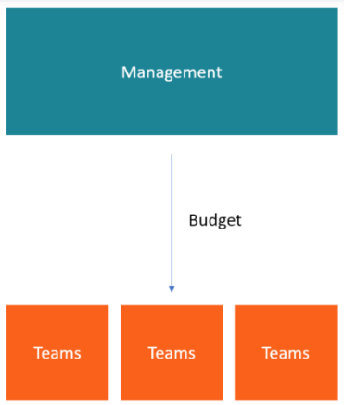
Top-Down Budgeting

Slide 54
Top-Down Budgeting
Budget Allocations to Departments
Department-level Budgets
Harmonization of Departmental Budgets

Slide 55
Advantages of Top-Down Budgeting
It allows management to allocate resources to departments with a view to propelling the growth of the company, starting with the most critical departments.
Saves time for lower management. Rather than spending time creating a budget from scratch, lower-level managers are given an already-formulated budget to implement.
Creates one budget at a time, rather than allowing departments to develop their budgets and later combining them. As a result, the budgeting process will be less tedious.

Slide 56
Disadvantages of Top-Down Budgeting
The level of motivation decreases since the managers who are required to implement the budget do not own the budget-making process.
2. Senior managers are not involved in the day-to-day operations of individual departments, so they may not have realistic expectations of the expenses related to each department.

Slide 57
Bottom-Up Budgeting
Bottom-up budgeting starts at the department level and moves up to the top management.
The departmental heads/managers prepare their budget based on present information and past experiences and present it to senior management for approval.

Slide 58
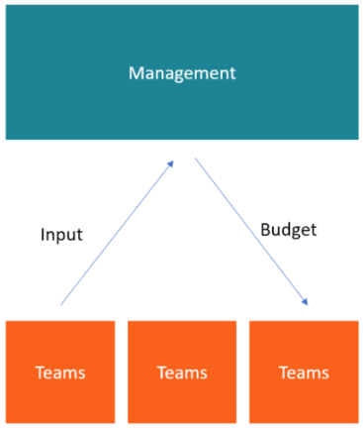
Bottom-Up Budgeting

Slide 59
Bottom-Up Budgeting
The bottom-up approach results in a more detailed schedule, but it’s also a time-consuming approach compared with the top-down task planning approach.
The schedule you create is based on direct input from experts who will be implementing the project; it’s also a useful technique to build teamwork.

Slide 60
Advantages of Bottom-up Budgeting
Typically very accurate because each department uses its specialized knowledge to create the individual line items of its budget.
Improves company morale and employee motivation since the whole team gets involved in formulating the budget and takes more ownership over achieving budgeted targets.
Helps management gain a deeper understanding and commitment to the business goals.

Slide 61
Disadvantages of Bottom-up Budgeting
Departments can become guilty of over-budgeting, getting too buried in detail and trying to budget for every single staple and pencil.
2. A department may set budget targets that are too easily achievable, and inexperienced managers could make poor decisions when estimating and calculating budget numbers.
3. The budgeting process may also take significantly longer because of all the people and departments involved.

Slide 62
Project Cost estimation
Cost estimation for a project involves assessing the expenses involved in completing the project within a certain scope, time frame, and quality standard. Here's a basic process for project cost estimation:
1. Define the Scope: Clearly outline what the project aims to achieve and what deliverables are expected.
2. Identify Tasks: Break down the project into smaller tasks or activities. This could be done using techniques like Work Breakdown Structure (WBS).
3. Estimate Resources: Determine what resources (people, materials, equipment) are needed for each task. Consider the quantity and quality of resources required.
4. Estimate Durations: Estimate the time required to complete each task. This involves considering factors like dependencies between tasks, resource availability, and potential risks.
5. Cost Rate Assignment: Assign cost rates to each resource based on their hourly or daily rates. This could include labor costs, material costs, equipment costs, etc.

Slide 63
Project Cost estimation
6. Calculate Costs: Multiply the estimated resource requirements by their corresponding cost rates to calculate the cost for each task.
7. Contingency Planning: Include a contingency allowance for unexpected events or changes in scope. This is usually a percentage of the total project cost.
8. Summarize and Review: Summarize the estimated costs for all tasks to get the total project cost. Review the estimation process to ensure accuracy and completeness.
9. Document and Present: Document the cost estimation process and results in a clear and transparent manner. Present the estimation to stakeholders for approval.
10. Monitor and Update: Continuously monitor actual project costs against the estimated costs throughout the project lifecycle. Update the cost estimation as needed to reflect any changes in scope, schedule, or resources.

Slide 64
Improving cost estimates
Improving cost estimates involves refining the estimation process to increase accuracy and reliability. Here are some strategies to improve cost estimates:
1. Gather Detailed Information: Collect as much detailed information about the project as possible, including project requirements, scope, constraints, and risks. The more information available, the more accurate the estimation can be.
2. Use Historical Data: Utilize historical data from past similar projects as a basis for estimating costs. This can include actual costs, durations, resource requirements, and lessons learned.
3. Involve Subject Matter Experts: Collaborate with subject matter experts from relevant domains to provide insights into resource requirements, potential risks, and other factors that may impact costs.
4. Refine Estimation Techniques: Use advanced estimation techniques such as parametric estimation, analogous estimation, and three-point estimation to account for uncertainty and variability in project parameters.

Slide 65
Improving cost estimates
5. Consider Multiple Scenarios: Evaluate different scenarios and assumptions to assess the range of potential costs. This helps in identifying and mitigating risks and uncertainties more effectively.
6. Account for Contingencies: Include contingency reserves in the cost estimation to account for unforeseen events, scope changes, and risks. A commonly used approach is to add a percentage of the total cost as a contingency allowance.
7. Validate Estimates: Validate cost estimates through peer reviews, benchmarking against industry standards, and comparing with similar projects. This helps in identifying any inconsistencies or biases in the estimation process.
8. Update Estimates Regularly: Continuously update cost estimates as the project progresses and more information becomes available. This helps in refining the estimates based on actual data and adjusting for changes in project scope, schedule, and resources.

Slide 66
Improving cost estimates
9. Document Assumptions and Rationale: Clearly document the assumptions, methodologies, and rationale behind the cost estimates. This enhances transparency and facilitates communication with stakeholders.
10. Learn from Experience: Analyze deviations between estimated and actual costs to learn from experience and improve future cost estimation processes. Document lessons learned to incorporate into future projects.

Slide 67
Budget uncertainty and risk management
Managing budget uncertainty and risk is crucial for the success of any project. Here's how you can effectively manage budget uncertainty and mitigate risks:
1. Identify and Analyze Risks: Conduct a thorough risk analysis to identify potential threats to the project budget. This involves identifying both internal and external factors that could impact costs, such as scope changes, resource constraints, market fluctuations, and unforeseen events.
2. Quantify Risks: Once risks are identified, quantify them in terms of their potential impact on the project budget. This can be done by estimating the probability of occurrence and the potential cost impact for each risk.
3. Develop Risk Response Strategies: Develop strategies to address identified risks, including risk mitigation, risk avoidance, risk transfer, and risk acceptance. For example, if there's a risk of material price escalation, you might consider hedging contracts or establishing contingency plans.
4. Allocate Contingency Reserves: Set aside contingency reserves within the project budget to account for known risks and uncertainties. These reserves act as a buffer to absorb cost overruns or unexpected expenses that may arise during project execution.
5. Monitor and Control Risks: Implement a robust risk monitoring and control process to track identified risks throughout the project lifecycle. Regularly review the status of risks, reassess their likelihood and impact, and update risk response strategies as needed.

Slide 68
Budget uncertainty and risk management
5. Monitor and Control Risks: Implement a robust risk monitoring and control process to track identified risks throughout the project lifecycle. Regularly review the status of risks, reassess their likelihood and impact, and update risk response strategies as needed.
6. Engage Stakeholders: Engage key stakeholders in the risk management process to ensure alignment and buy-in. Solicit input from stakeholders to identify risks, assess their potential impact, and develop appropriate risk response strategies.
7. Utilize Risk Management Tools: Utilize risk management tools and techniques such as risk registers, risk matrices, and Monte Carlo simulations to systematically manage and analyze project risks.
8. Communicate Effectively: Maintain open and transparent communication channels with stakeholders regarding budget uncertainties and associated risks. Keep stakeholders informed about the status of risks, mitigation efforts, and any changes to the project budget.
9. Learn from Past Projects: Continuously learn from past projects by analyzing historical data and lessons learned. Identify recurring patterns or common sources of budget uncertainty and incorporate best practices into future projects.
10. Iterative Planning and Forecasting: Embrace an iterative approach to project planning and forecasting, allowing for flexibility and adaptation to changing circumstances. Regularly revisit and update the project budget based on new information and evolving risks.

Slide 69
Scheduling the project
Scheduling a project involves creating a timeline that outlines the sequence of tasks and activities required to complete the project within a specific timeframe. Here's a step-by-step guide to effectively schedule a project:
1. Define Project Scope and Objectives: Clearly define the project scope, objectives, deliverables, and milestones. Understanding the scope of work is essential for developing an accurate project schedule.
2. Identify Tasks and Activities: Break down the project into smaller, manageable tasks and activities. Use techniques such as Work Breakdown Structure (WBS) to decompose the project scope into actionable items.
3. Sequence Tasks: Determine the logical sequence in which tasks need to be performed. Identify dependencies between tasks, such as finish-to-start, start-to-start, finish-to-finish, and start-to-finish relationships.

Slide 70
Scheduling the project
4. Estimate Task Durations: Estimate the duration required to complete each task. Use historical data, expert judgment, and input from team members to make realistic estimates. Consider factors such as resource availability, dependencies, and constraints.
5. Allocate Resources: Assign resources (human, material, and equipment) to each task based on their availability, skills, and expertise. Ensure that resources are allocated efficiently to avoid overloading or underutilization.
6. Develop the Project Schedule: Use scheduling tools such as Gantt charts, network diagrams, or project management software to create the project schedule. Input task durations, dependencies, and resource assignments to generate a timeline for the project.
7. Optimize the Schedule: Review the initial schedule to identify opportunities for optimization and improvement. Look for ways to minimize critical path length, balance resource workloads, and streamline task sequences.

Slide 71
Scheduling the project
8. Account for Contingencies: Incorporate contingency buffers into the project schedule to account for uncertainties, risks, and unexpected delays. Allocate additional time for critical tasks or activities that have a high risk of overrun.
9. Set Milestones and Deadlines: Define key milestones and deadlines to track progress and measure project performance. Milestones serve as checkpoints to mark significant achievements or deliverables throughout the project lifecycle.
10. Communicate and Collaborate: Share the project schedule with stakeholders, team members, and other relevant parties. Ensure that everyone understands their roles, responsibilities, and timelines. Encourage collaboration and communication to address any issues or conflicts that may arise.
11. Monitor and Update the Schedule: Continuously monitor progress against the project schedule and update it as needed. Track actual progress, identify deviations from the planned timeline, and take corrective actions to keep the project on track.

Slide 72
Gantt Chart
A Gantt chart is a widely used tool in software project management that provides a graphical representation of a project schedule. It shows the start and finish dates of various elements of a project, allowing project managers to track progress, allocate resources, and plan for future tasks. Gantt charts are valuable for visualizing project timelines, dependencies between tasks, and the overall project schedule.
Key Components of a Gantt Chart:
Tasks/Activities: List of all the tasks or activities that need to be completed for the project.
Timeline: Horizontal axis representing the project timeline. It can be in days, weeks, months, etc.
Bars: Bars represent tasks on the chart. The length of the bar indicates the duration of the task. Tasks can be displayed sequentially or in parallel based on their dependencies.
Dependencies: Relationships between tasks, often represented by lines connecting task bars. Dependencies can be of different types, such as finish-to-start, start-to-start, finish-to-finish, or start-to-finish.
Milestones: Significant points or achievements in the project. They are usually represented as diamond-shaped markers on the chart.

Slide 73
Steps to Create a Gantt Chart:
Identify Tasks: List down all the tasks or activities that need to be completed for the project. Be specific and detailed about each task.
Estimate Durations: Estimate the time required to complete each task. This could be in days, weeks, or any other unit of time relevant to your project.
Sequence Tasks: Determine the order in which tasks need to be completed. Identify dependencies between tasks (which tasks need to be finished before others can start).
Create the Chart: Using software tools like Microsoft Project, Excel, or specialized project management software, create the Gantt chart. Input task names, start dates, and durations to generate the chart.
Add Dependencies: Indicate task dependencies using lines connecting the bars. This shows which tasks are dependent on the completion of others.
Include Milestones: If your project has significant milestones, add them to the chart as diamond-shaped markers.
Adjust and Update: As the project progresses, update the chart to reflect the actual start and finish dates. Adjust the chart for any changes in task duration or dependencies.

Slide 74
Gantt Chart and RAM
Task | Duration (weeks) | Start Date | End Date | Dependencies
Requirements | 2 | 01/01/2023 | 01/14/2023 | None
Design | 3 | 01/15/2023 | 02/04/2023 | Requirements
Frontend Development | 4 | 02/05/2023 | 03/04/2023 | Design
Backend Development | 4 | 02/05/2023 | 03/04/2023 | Design
Testing | 2 | 03/05/2023 | 03/18/2023 | Frontend, Backend
Deployment | 1 | 03/19/2023 | 03/25/2023 | Testing

Slide 75
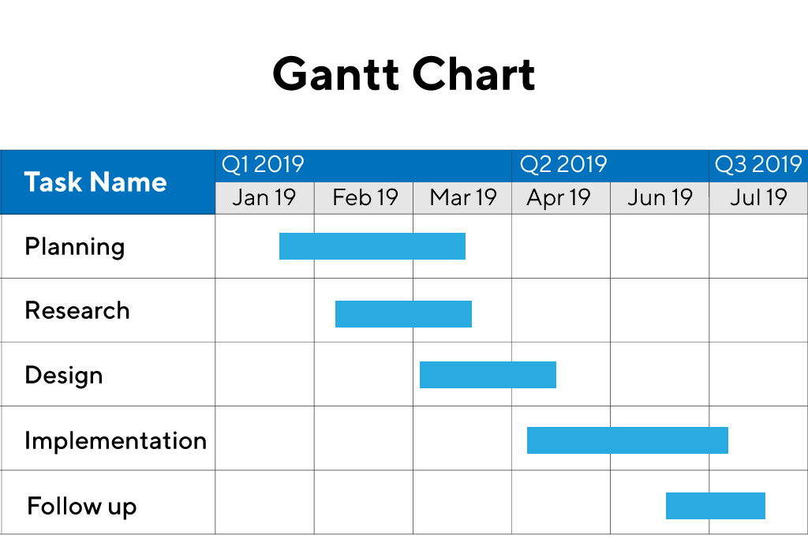
Example of Gantt Chart

Slide 76
Resource allocation and loading
The social cost-benefit analysis is a tool for evaluating the value of money, particularly of public investments in many economies.
It aids in making decisions with respect to the various aspects of a project and the design programs of closely interrelated projects.
Cost benefit analysis has become important among economists and consultants in recent years.

Slide 77
Social Cost Benefit Analysis (SCBA)
The social cost-benefit analysis is a tool for evaluating the value of money, particularly of public investments in many economies.
It aids in making decisions with respect to the various aspects of a project and the design programs of closely interrelated projects.
Cost benefit analysis has become important among economists and consultants in recent years.

Slide 78
Rationale Behind SCBA
In Social-Cost Benefit Analysis (SCBA) the focus is on social costs and benefits of a project.
These often tend to differ from the costs incurred in monetary terms and benefits earned in monetary terms by the project.

Slide 79
Rationale Behind SCBA
The principal reasons for discrepancy are:
Market imperfections
Externalities
Taxes and subsidies
Concern for savings
Concern for redistribution
Merit wants

Slide 80
UNIDO Approach to SCBA
Calculation of financial profitability of the project measured at market prices.
Obtaining the net benefit of project measured in terms of economic (efficiency) prices.
Adjustment for the impact of the project on savings and investment.
Adjustment for the impact of the project on income distribution.
Adjustment for the impact of project on merit goods and demerit goods whose social values differ from their economic values.

Slide 81
UNIDO Approach
Stage 1
The financial profitability of the projects is calculated by making the projected financial statements that serve as a focus for future earnings and sustainability of the projects

Slide 82
UNIDO Approach
Stage 2
Stage two of the UNIDO approach is Concerned with the determination of the net benefit of the project in terms of economic (efficiency) prices, also referred to as shadow prices.

Slide 83
Shadow Pricing
The UNIDO approach suggests following sources of shadow pricing, depending on the impact of the project on national economy. A project as it uses and produces resources may for any given input or output
(i) increase or decrease the total consumption in the economy,
(ii) decrease or increase production in the economy,
(iii) decrease imports or increase imports, or
(iv) increase exports or decrease exports.

Slide 84
NON-TRADABLE INPUTS AND OUTPUTS
A good is non-tradable when the following conditions are satisfied:
I) its import price is greater than its domestic cost of production and
(ii) its export price is less than its domestic cost of production.
Valuation is done as:

Slide 85
Externalities
An externality, also referred to as an external effect, is a special class of good which has the following characteristics:
(i) It is not deliberately created by the project sponsor but is an incidental outcome of legitimate economic activity,
(ii) It is beyond the control of the persons who are affected by it, for better or for worse.
(iii) It is not traded in the market place.
An external effect may be beneficial or harmful.

Slide 86
Measurement of the impact on distribution
Stage 3 & 4
Stages three and four of the UNIDO method are concerned with measuring the value of a project in terms of its contribution to savings
and income redistribution.
To facilitate such assessments we must first measure the income gained or lost by individual groups within the society.

Slide 87
How to distribute society?
For income distribution analysis, the society may be divided into various groups. The UNIDO approach seeks to identify income gains and losses by the following:
(i) Project,
(ii) Other private business,
(iii) Government,
(iv) Workers,
(v) Consumers,
(vi) External sector.

Slide 88
Savings impact and its value
Stage three of the UNIDO method, concerned with this, seeks to answer the following questions:
(i) Given the income distribution impact of the project what would be its effect on savings?
(ii) What is the value of such savings to the society?
Impact on savings of a project = ΣΔYiMPSi
where, ΔYi = change in income of group i as a result of the project
MPSi = marginal propensity to save of group i

Slide 89
Savings impact and its value
If the marginal productivity of capital is r and the rate of reinvestment from additional income a, the additional stream of consumption generated by a rupee of investment can be worked out.
The consumption stream starts with r (1 – a) and grows annually at the rate of ar forever.

Slide 90
Savings impact and its value
I = r(1-a) / (k-ar)
where,
I = social value of a rupee of savings (investment)
r = marginal productivity of capital
a = reinvestment rate on additional income arising from investment
k = social discount rate.

Slide 91
Income Distribution Impact
Many Governments regard redistribution of income in favour of economically weaker sections or economically backward regions as a socially desirable objective.
Due to practical difficulties in pursuing the objective of redistribution entirely through the tax, subsidy, and transfer measures of the government, investment projects are also considered as instruments for income redistribution and their contribution toward this goal is considered in their evaluation.

Slide 92
Adjustment for Merit and Demerit Goods
In some case, the analysis has to be extended beyond stage four to reflect the difference between the economic value and social value of resources. This difference exists in the case of merit goods and demerit goods.
A merit good is one for which the social value exceeds the economic value.
In the case of a demerit good, the social value of the good is less than its economic value

Slide 93
Adjusting for the difference between social value and economic value
(i) Estimate the economic value.
(ii) Calculate the adjustment factor as difference between the ratio of social value to economic value and unity.
(iii) Multiply the economic value by the adjustment factor to obtain the adjustment.
(iv) Add the adjustment to the net present value of the project as calculated in stage four.

Slide 94
Little-Mirrlees Approach to SCBA
The LM Approach provides a comprehensive framework for SCBA in developing countries.
The approach has been named on the basis of their developers i.e. L. M. D. Little and J. A. Mirrlees.

Slide 95
Little-Mirrlees Approach to SCBA
Under LM approach costs and benefits are measured in terms of international prices, also referred as border prices. The following are the provisions related with traded goods:
1. FOB Price(MOVEMENT BORNE BY SELLER): if a good is exported, its shadow price is its FOB price.
2. CIF Price(SELLER’S RESPONSIBILITY FOR THE COST, INSURANCE , FREIGHT): If a good is imported its shadow price is it CIF price.

Slide 96
Little-Mirrlees Approach to SCBA
Shadow Prices of Non-Traded Goods:
Shadow prices of non-traded goods are defined in terms of marginal social cost and benefit. The resource used to produce an extra unit of a good is the marginal cost of a good. The value of an extra unit of the good from social point of view is the marginal social benefit.

Slide 97
Little-Mirrlees Approach to SCBA
Shadow Prices of Non-Traded Goods:
When a good is not taxed and is consumed by only one income group, then its marginal social benefit is equal to its market price multiplied by a factor which represents the value assigned to an increase in the income of that group vis-vis an consumption is 2:1,
then the shadow price of thee non-traded output will be:
2/3 marginal social cost + 1/3 marginal social benefit

Slide 98
Summary
The project cost is a cost required to procure all the needed products, services and resources to deliver the project successfully.
The Project Budget is a tool used by project managers to estimate the total cost of a project.
The social cost-benefit analysis is a tool for evaluating the value of money, particularly of public investments in many economies.

Slide 99
Youtube Links
https://www.youtube.com/watch?v=KBhREhTe82Q
https://www.youtube.com/watch?v=Ni95eCqOMhg
https://www.youtube.com/watch?v=2HjrfMhvPFI
https://www.youtube.com/watch?v=HY6tVBQXbOg

Slide 100
Daily Quiz
Q1. Discuss the fixed cost.
Q2. Describe the variable cost.
Q3. Explain the normal and expedite cost.
Q4. Explain the top down budgeting.
Q5. Discuss the bottom of budgeting.

Slide 101
Daily Quiz
Q6. The cost of project represents the_______ of all items of outlet associated.
Total
Partial
Both the above
None of the above
Q7. The cost of land at a given time varies considerably from one_______ to another.
A. Location
B. Seller
C. Buyer
D. None of these

Slide 102
Daily Quiz
Q8. From the private point of view, taxes are.
Definite monetary costs
Definite monetary gains
Definite monetary losses
None of the above
Q9. The common market imperfections found in developing countries are:
Rationing,
Prescription of minimum wage rates
Foreign exchange regulation.
All of the above

Slide 103
Weekly Assignment
Q1. Describe various costs associated with project management.
Q2. Enumerate various project financing sources
Q3. Discuss the Social Cost Benefit Analysis (SCBA). Describe the UNIDO approach to SCBA
Q4. Discuss various approaches of project budgeting.

Slide 104
MCQ s
Q1. Most of the projects incur cash losses in the________.
Initial years
During the peak
Later years
None of these
Q2. Equity shareholders are the________ of the business.
Debtors
Owners
Borrowers
None of the above

Slide 105
MCQ s
Q3. Debentures are the instrument for raising the_______
Equity capital
Debt capital
Preference capital
All of the above
Q4. The cost which does not change with the level of activity in short run is known as
Variable cost
Fixed cost
Average cost
None of the above

Slide 106
MCQ s
Q5. SCBA stands for.
Social cost benefit analysis
Society contribution for beta analysis
Singular characteristic beta aggregation
None of the above
Q6. When imperfections obtain, market prices do not reflect.
Economic value
Social value
Financial value
Intrinsic value

Slide 107
Glossary Questions
Part of Question Bank. .
Yet to be prepared for IV sem Batch 2020-22

Slide 108
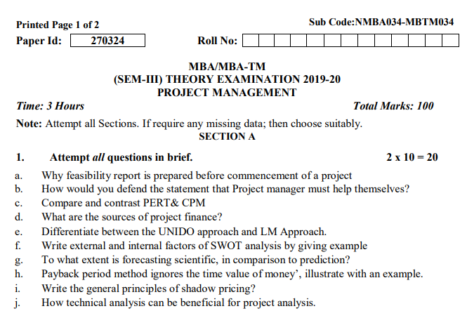
Old Question Papers

Slide 109
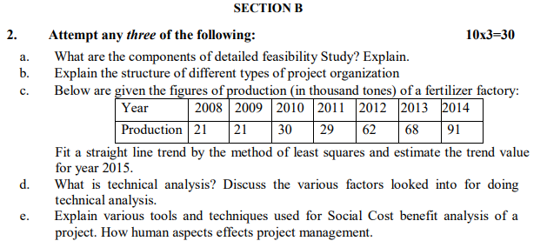
Old Question Papers

Slide 110
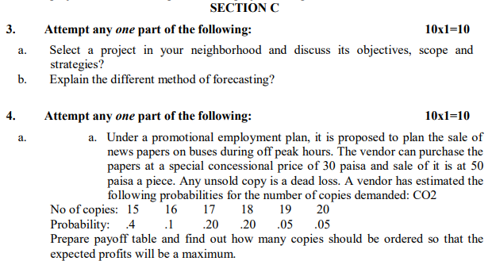
Old Question Papers

Slide 111
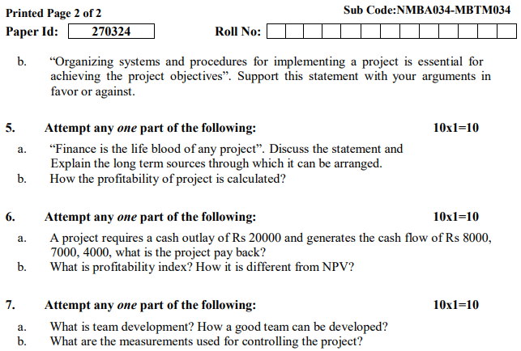
Old Question Papers

Slide 112
Expected Questions for University Exam
Q1. Discuss the various types of cost associated with the project management.
Q2. Elaborate the Little-Mirrlees approach of social cost benefit analysis.
Q3. Explain social cost benefit analysis. Discuss the UNIDO approach of this analysis.
Q4. Differentiate between the top-down and bottom-up budgeting.
Q5. Explain the various sources of project financing in India.

Slide 113
Summary/Recap
Resource planning is the process of ascertaining future resource requirements for an organization or a scope of work.
Budgeting is a sub-process within estimating used for allocating the estimated cost of resources into cost accounts against which cost performance will be measured and assessed. This forms the baseline for cost control.
Under LM approach costs and benefits are measured in terms of international prices, also referred as border prices.

Slide 114
References
https://global.oup.com/us/companion.websites/fdscontent/uscompanion/us/static/companion.websites/9780195161526/interactive/ED/ECA.htm#:~:text=A%20recurring%20cost%20is%20one,and%20is%20not%20generally%20anticipated.
http://jrajeshprojectmanagement.blogspot.com/2017/04/discuss-unido-approach-of-social-cost.html
http://epgp.inflibnet.ac.in/epgpdata/uploads/epgp_content/S000438BE/P000735/M014897/ET/1458723523BSE_P16_M24_etext.pdf
Books
1. Project Management – Achieving Competitive Advantage: Jeffrey K. Pinto (Pearson)
2. Project Management- A Managerial Approach: Jack R. Meredith Broyhill Samuel J. Mantel, Jr (John Wiley & Sons)
4. Project- Preparation, Appraisal, Budgeting and Implementation: Chandra Prasanna - (TMH)

Slide 115
Thank You

